Slide 1

SPK dan SC Inferensi dan Mesin Inferensi
Sistem cerdas dan Pendukung Keputusan
Dr. Herlina Jayadianti. ST.MT

Slide 2
Inferencing
Expert system programming is distinctively different from conventional programming.

Slide 3
Inferencing
Whereas one could describe a conventional program (or at least, the part of it that produces the results, as opposed to the user interface, etc) in these terms:
Program = algorithm + data
one would have to describe an expert system in these terms:
Expert system = inference engine +
knowledge base + data.

Slide 4
EXPERT SYSTEM
Expert systems often present difficult knowledge representation and reasoning problems which require artificial intelligence solutions.
The need for heuristic reasoning.
Conventional computer programs are built around algorithms: reasoning strategies which are guaranteed to find the solution to whatever the problem is, if there is such a solution.
For the large, difficult problems with which expert systems are frequently concerned, it may be necessary to employ heuristics: strategies that often lead to the correct solution, but which also sometimes fail.

Slide 5
ALGORITHM
Algorithm - a strategy, consisting of a series of steps, guaranteed to find the solution to a problem, if there is a solution.
Example:
How do you find the area of a triangular board, standing up vertically with one edge on the ground?
Measure the length of the edge on the ground, multiply it by the vertical height, and divide by two.
The answer will be exactly right, every time.
Which makes it an algorithm.

Slide 6
HEURISTIC
Heuristic - a strategy to find the solution to a problem which is not guaranteed to work.
One sort of heuristic usually gives you the right answer but sometimes gives you the wrong answer
Another sort gives you an answer which isn’t 100% accurate.
Example:
How old are you?
Subtract the year you were born in from 2001.
The answer will either be exactly right, or one year short.
Which makes it a heuristic.

Slide 7

Inferencing? Inferensi?

Slide 8
Proses penarikan kesimpulan dari beberapa proposisi ini disebut inferensi (inference).
Terdapat sejumlah kaidah inferensi di dalam kalkulus proposisi, beberapa diantaranya adalah sebagai berikut :

Slide 9
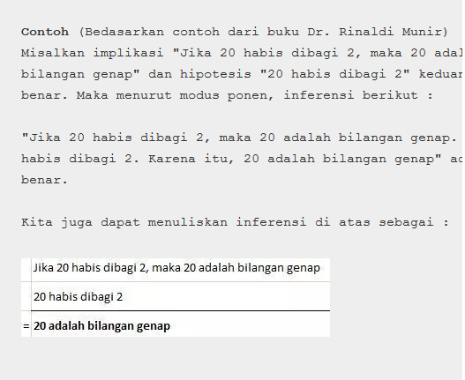
1. Modus Ponen
Kaidah ini didasarkan pada tautologi (p ∧ (p → q)) → q, yang dalam hal ini, p dan p → q adalah hipotesis, sedangkan q adalah konklusi.
Kaidah modus ponen dapat ditulis dengan cara :
Modus ponen menyatakan bahwa jika hipotesis p dan implikasi p→q benar, maka konklusi q benar.

Slide 10
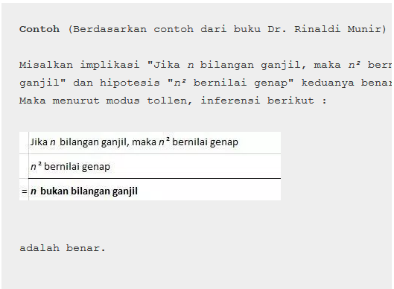
2. Modus Tollen
Kaidah ini didasarkan pada tautologi [~q ∧ (p → q)] → ~p, Kaidah modus Tollen

Slide 11
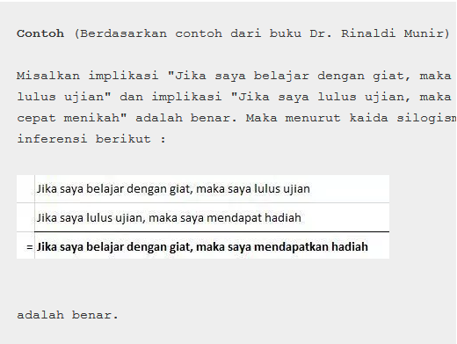
3. Silogisme Hipotesis
Kaidah ini didasarkan pada tautologi [(p → q) ∧ (q → r)] → (p → r). Kaidah silogisme

Slide 12
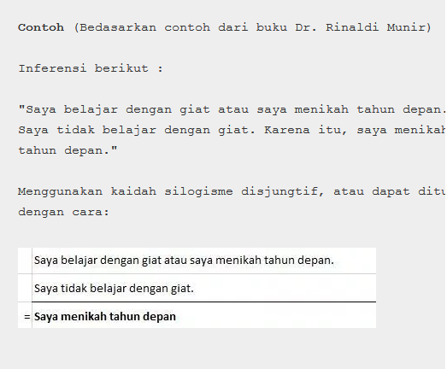
4. Silogisme Disjungtif
Kaidah ini didasarkan pada tautologi [(p ∨ q) ∧ ~p] → q. Kaidah silogisme disjungtif

Slide 13
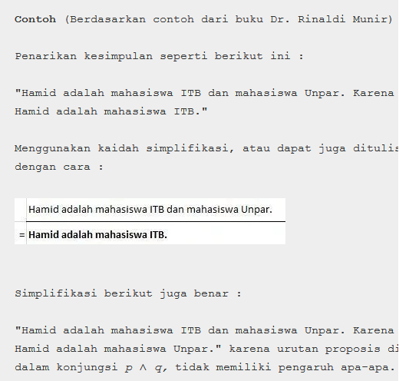
5. Simplifikasi
Kaidah ini didasarkan pada tautologi (p ∧ q) → p, yang dalam hal ini, p dan q adalah hipotesis, sedangkan p adalah konklusi. Kaidah simplifikasi

Slide 14
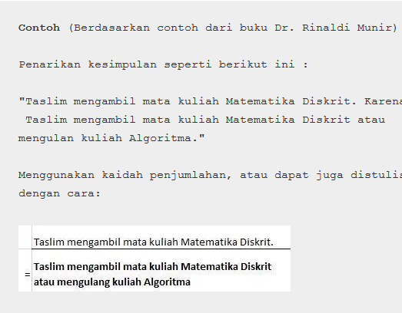
6. Penjumlahan
Kaidah ini didasarkan pada tautologi p → (p ∨ q). Kaidah penjumlahan

Slide 15
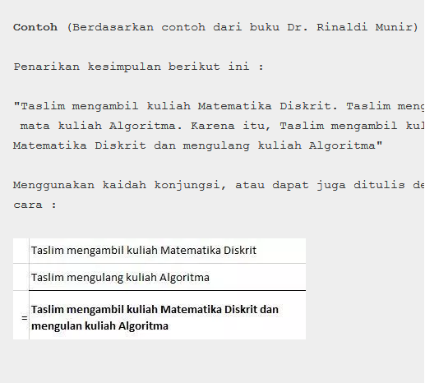
7. Konjungsi
Kaidah ini didasarkan pada tautologi ((p) ∧ (q)) → (p ∧ q). Kaidah konjungsi

Slide 16
Inferensi & Mesin Inferensi
Inferensi :proses untuk menghasilkan informasi yang berasal dari fakta yang diketahui atau diusulkan
Mesin Inferensi : mengandung pola pikir dan penalaran dalam menyelesaikan masalah
Mesin inferensi
Merupakan program komputer
Memberikan metodologi untuk penalaran tentang informasi yang ada dalam basis pengetahuan dan dalam workplace
Untuk mengformulasikan kesimpulan

Slide 17
Strategi Penalaran
Runut Maju / Forward Chaining
Runut Balik / Backward Chaining

Slide 18
Runut Maju
Runut maju berarti menggunakan himpunan aturan kondisi-aksi.
Dalam metode ini, data digunakan untuk menentukan aturan mana yang akan dijalankan, kemudian aturan tersebut dijalankan.
Mungkin proses menambahkan data ke memori kerja.
Proses diulang sampai ditemukan suatu hasil

Slide 19
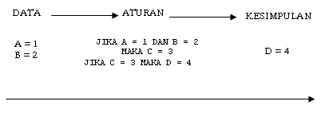

Slide 20
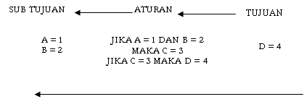
Runut Balik
penalaran dimulai dengan tujuan kemudian merunut balik ke jalur yang akan mengarahkan ke tujuan tersebut

Slide 21
Inference in rule-based systems

Slide 22
Inference in rule-based systems
Two control strategies: forward chaining and backward chaining

Slide 23
Inference in rule-based systems
Forward chaining: working from the facts to a conclusion. Sometimes called the data-driven approach. To chain forward, match data in working memory against 'conditions' of rules in the rule-base.
As described in some detail last week

Slide 24
Inference in rule-based systems
To chain forward, match data in working memory against 'conditions' of rules in the rule-base.
When one of them fires, this is liable to produce more data.
So the cycle continues

Slide 25
Inference in rule-based systems
Backward chaining: working from the conclusion to the facts. Sometimes called the goal-driven approach.
To chain backward, match a goal in working memory against 'conclusions' of rules in the rule-base.
When one of them fires, this is liable to produce more goals.
So the cycle continues.

Slide 26
Forward & backward chaining
e.g. Here are two rules:
If corn is grown on poor soil, then it will get blackfly.
If soil hasn't enough nitrogen, then it is poor soil.
Forward chaining: This soil is low in nitrogen; therefore this is poor soil; therefore corn grown on it will get blackfly.
Backward chaining: This corn has blackfly; therefore it must have been grown on poor soil; therefore the soil must be low in nitrogen.

Slide 27
Backward chaining
More realistically,
the forward chaining reasoning would be: there's something wrong with this corn. So I test the soil. It turns out to be low in nitrogen. If that’s the case, corn grown on it will get blackfly. Therefore the problem is blackfly caused by low nitrogen.

Slide 28
Backward chaining
More realistically,
the backward chaining reasoning would be: there's something wrong with this corn. Perhaps it has blackfly; if so, it must have been grown on poor soil; if so, the soil must be low in nitrogen. So test for low nitrogen content in soil, and then we'll know whether the problem was blackfly.

Slide 29
Forward & backward chaining
The choice of strategy depends on the nature of the problem.
Assume the problem is to get from facts to a goal (e.g. symptoms to a diagnosis).

Slide 30
Forward & backward chaining
Backward chaining is the best choice if:
The goal is given in the problem statement, or can sensibly be guessed at the beginning of the consultation;
or:
The system has been built so that it sometimes asks for pieces of data (e.g. "please now do the gram test on the patient's blood, and tell me the result"), rather than expecting all the facts to be presented to it.

Slide 31
Forward & backward chaining
Backward chaining
This is because (especially in the medical domain) the test may be
expensive,
or unpleasant,
or dangerous for the human participant
so one would want to avoid doing such a test unless there was a good reason for it.

Slide 32
Forward & backward chaining
Forward chaining is the best choice if:
All the facts are provided with the problem statement;
or:
There are many possible goals, and a smaller number of patterns of data;
or:
There isn't any sensible way to guess what the goal is at the beginning of the consultation.

Slide 33
Forward & backward chaining
Note also that
a backwards-chaining system tends to produce a sequence of questions which seems focussed and logical to the user,
a forward-chaining system tends to produce a sequence which seems random & unconnected.
If it is important that the system should seem to behave like a human expert, backward chaining is probably the best choice.

Slide 34
Forward & backward chaining
Some systems use mixed chaining, where some of the rules are specifically used for chaining forwards, and others for chaining backwards. The strategy is for the system to chain in one direction, then switch to the other direction, so that:
the diagnosis is found with maximum efficiency;
the system's behaviour is perceived as "human".

Slide 35
Meta-rules
Meta-rules are rules which alter the reasoning process: these can make a production system more flexible.
e.g. a rule which chooses a particular style of conflict-resolution, on the basis of data in the working memory.
Or a rule which switches from forward to backward chaining at a suitable moment in the reasoning process.
Or a rule which "decides" to consider a certain type of rule before other types.

Slide 36
Pengontrolan inferensi
Contoh:
Ada 10 aturan yang tersimpan dalam basis pengetahuan.
Fakta awal yang diberikan hanya: A & E (artinya: A dan E bernilai benar).
Ingin dibuktikan apakah K bernilai benar (hipotesis: K)?
No. | Aturan
R-1 | IF A & B THEN C
R-2 | IF C THEN D
R-3 | IF A & E THEN F
R-4 | IF A THEN G
R-5 | IF F & G THEN D
R-6 | IF G & E THEN H
R-7 | IF C & H THEN I
R-8 | IF I & A THEN J
R-9 | IF G THEN J
R-10 | IF J THEN K

Slide 37
Forward Chaining
Munculnya fakta baru pada saat inferensi:
Aturan | Fakta Baru
R-3 | F
R-4 | G
R-5 | D
R-6 | H
R-9 | J
R-10 | K

Slide 38
Alur inferensi:
J
R-10
K
R-9
Fakta
R-4
G
A
R-5
F
D
R-3
H
R-6
E
Fakta

Slide 39
Backward Chaining
Alur inferensi:
Fakta
K
R-10
J
I
C
A
R-8
R-7
R-1
A
H
B
Tidak diketahui
(a) Pertama: Gagal
Fakta
K
R-10
J
R-9
G
R-4
A
(b) Kedua: Sukses

